Slide 1
Welcome! We are glad you are here

Slide 2
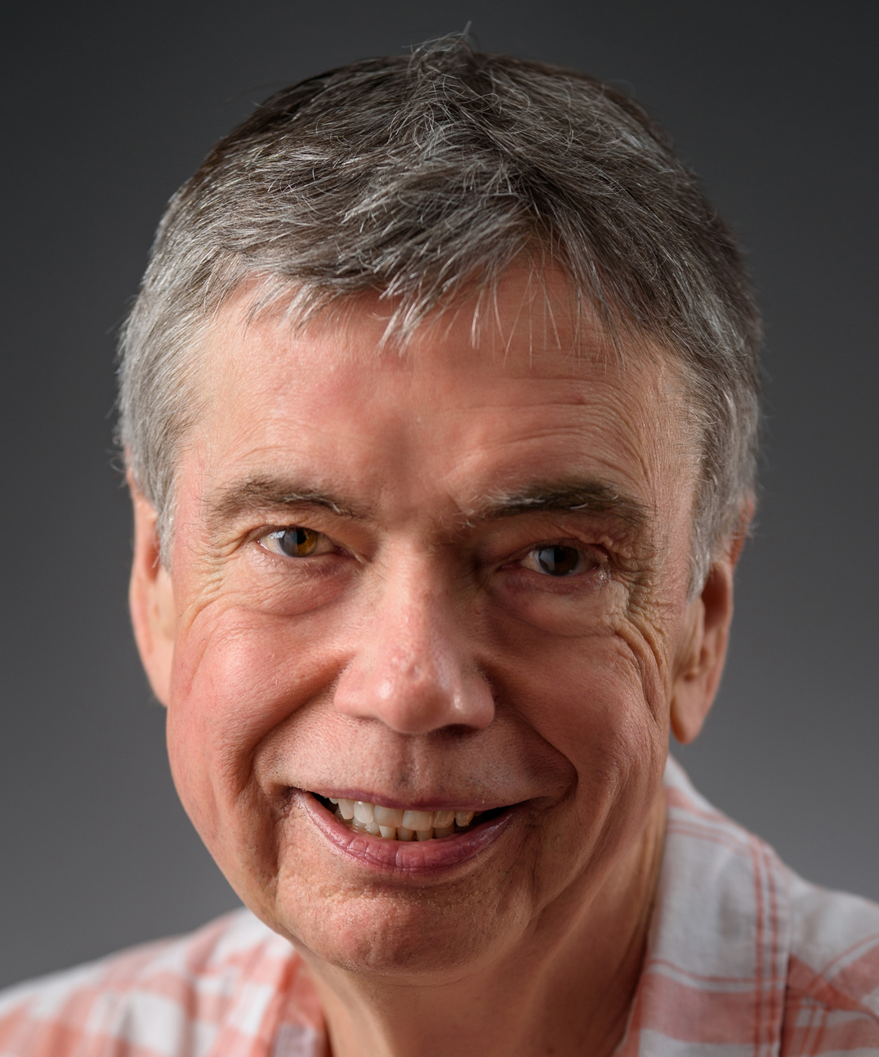
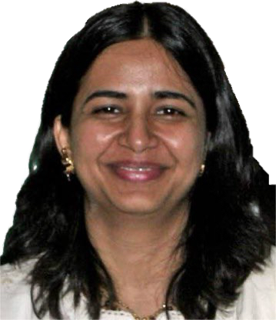
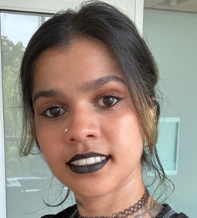
Helpful locals
Gary Ferland
Maryam Dehghanian
Chamani Gunasekera
Gargi Shaw

Slide 3
The agenda
Each day has one Chapter from Osterbrock & Ferland, and video Cloudy demos
There will be lectures by the developers
Most of the work will be in the group projects

Slide 4
Group projects
Break up into small groups of like-minded participants
Define a research problem you will do using Cloudy
The project/group must have a memorable name (needed to get grants or telescope time)
Give brief presentations of the projects at the end of each day
(See projects from old workshops)

Slide 5
Some rules
Rule 1: There are no rules
Rule 2: Research is what you are doing when you don’t know what you are doing
Rule 3: You can switch groups if you like, or form a new group with other participants
Rule 4: We end each day for a summary of the group’s progress and problems

